Slide 1

π
Runnables
May 2024
π

Slide 2

π
Tools We will cover?

Slide 3
π
TextSplitter
Basic
Lengthbase txt Splitter (CharactertextSplitter)
StructureBasedSplitter (RecursiveCharacterTextSplitter)
PythoneCodebase Splitter
Semantic Based text Chunking (Experimental Phase)
π

Slide 4
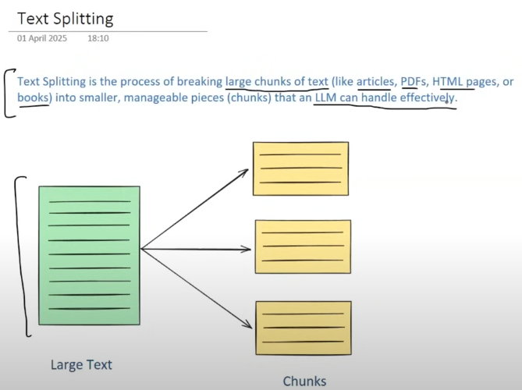
π
Text Splitting

Slide 5
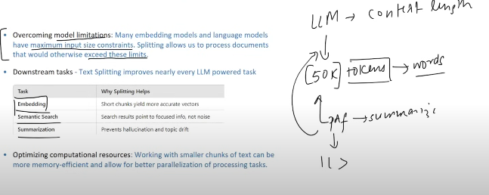
π
If we generate the embedding of entire paragraph totgether then the quality of embedding is not good.then vector is unbale to respsent sementaic meting of whole paragraph properly.
if we break entire paragrpah in small chunk first and then generate embediing of it.this case vector is able to represnet sementic meaning of it clearly.
Notes:
Content: https://www.linkedin.com/pulse/chunking-strategies-ai-data-kash-kashyap-0lghe/

Slide 6
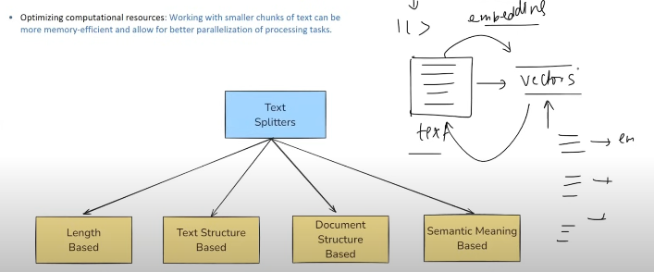
π
Notes:
Content: https://www.linkedin.com/pulse/chunking-strategies-ai-data-kash-kashyap-0lghe/

Slide 7
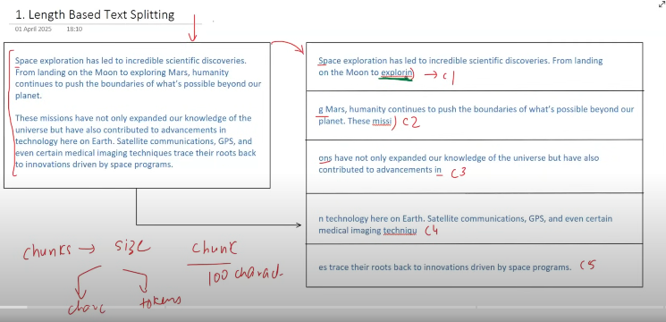
π
Notes:
Content: https://www.linkedin.com/pulse/chunking-strategies-ai-data-kash-kashyap-0lghe/

Slide 8
π
length based Text Splitter
Space exploration has led to incredible scientific discoveries. From landing on the Moon to exploring Mars, humanity continues to push the boundaries of what’s possible beyond our planet.
These missions have not only expanded our knowledge of the universe but have also contributed to advancements in technology here on Earth. Satellite communications, GPS, and even certain medical imaging techniques trace their roots back to innovations driven by space programs
character based splitter does not care about
grammar,
word
paragraph sentence,, also semantic meaning
https://chunkviz.up.railway.app/
Notes:
Content: https://www.linkedin.com/pulse/chunking-strategies-ai-data-kash-kashyap-0lghe/

Slide 9
π
from langchain_community.document_loaders import TextLoader
from langchain.text_splitter import CharacterTextSplitter
loader=TextLoader('test.txt')
docs=loader.load()
splitter =CharacterTextSplitter(
chunk_size=50,
chunk_overlap=10,
separator=""
)
result=splitter.split_documents(docs)
print(result)
TextLoader
Notes:
Content: https://www.linkedin.com/pulse/chunking-strategies-ai-data-kash-kashyap-0lghe/

Slide 10
π
from langchain_community.document_loaders import PyPDFLoader
from langchain.text_splitter import CharacterTextSplitter
loader=TextLoader('dl-curriculum.pdf')
docs=loader.load()
splitter =CharacterTextSplitter(
chunk_size=50,
chunk_overlap=10,
separator=""
)
result=splitter.split_documents(docs)
print(result)
PyPDFLoader
Notes:
Content: https://www.linkedin.com/pulse/chunking-strategies-ai-data-kash-kashyap-0lghe/

Slide 11
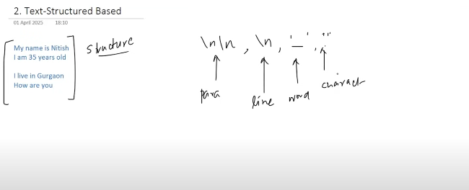
π
Structure based Text Splitter
Recursive text splitter do,
first try to make chunk based on paragraph if chunk is not formed on basis of paragraph, then it tries to make on basis of line it not able to make chunk again on basis of line then move on word .finally it choose character if unable to make chunk on basis of paragraph ,line, word
Notes:
Content: https://www.linkedin.com/pulse/chunking-strategies-ai-data-kash-kashyap-0lghe/

Slide 12
π
my name is Nitish(17)
i am 35 years old(17)
i live in Gurgaon(17)
how are you(11)
Allowed
[Chunk-size=10]
i live in Gurgaon(17)
how are you(11)
28
my name is Nitish(17)
i am 35 years old(17)
34
i live in Gurgaon(17)
how are you(11)
my name is Nitish(17)
i am 35 years old(17)
my(2)
Nitish(4)
is(2)
Nitish(6)
Notes:
Content: https://www.linkedin.com/pulse/chunking-strategies-ai-data-kash-kashyap-0lghe/

Slide 13
π
from langchain.text_splitter import RecursiveCharacterTextSplitter
text = """
Space exploration has led to incredible scientific discoveries. From landing on the Moon to exploring Mars, humanity continues to push the boundaries of what’s possible beyond our planet.
These missions have not only expanded our knowledge of the universe but have also contributed to advancements in technology here on Earth. Satellite communications, GPS, and even certain medical imaging techniques trace their roots back to innovations driven by space programs.
"""
splitter=RecursiveCharacterTextSplitter(
chunk_size=300,
chunk_overlap=0
)
result=splitter.split_text(text=text)
print(result)
RecursiveCharacterTextSplitter
Notes:
Content: https://www.linkedin.com/pulse/chunking-strategies-ai-data-kash-kashyap-0lghe/

Slide 14
π
Python Code Text Splitter
from langchain.text_splitter import RecursiveCharacterTextSplitter,Language
splitter=RecursiveCharacterTextSplitter.from_language( chunk_size=300, chunk_overlap=0, language=Language.PYTHON)
text = """
class Student:
def __init__(self, name, age, grade):
self.name = name
self.age = age
self.grade = grade # Grade is a float (like 8.5 or 9.2)
def get_details(self):
return self.name"
def is_passing(self):
return self.grade >= 6.0 # Example usage
student1 = Student("Aarav", 20, 8.2)
print(student1.get_details())
if student1.is_passing():
print("The student is passing.")
else:
print("The student is not passing.")
""" docs=splitter.split_text(text) print(docs)
Python Code Text Splitter
Notes:
Content: https://www.linkedin.com/pulse/chunking-strategies-ai-data-kash-kashyap-0lghe/

Slide 15
π
Semantic meaning Based Text Splitter
Two chunk
Farmers
IPL
Farmers were working hard in the fields, preparing the soil and planting seeds for the next season. The sun was bright, and the air smelled of earth and fresh grass. The Indian Premier League (IPL) is the biggest cricket league in the world. People all over the world watch the matches and cheer for their favorite teams.
Terrorism is a big danger to peace and safety. It causes harm to people and creates fear in cities and villages. When such attacks happen, they leave behind pain and sadness. To fight terrorism, we need strong laws, alert security forces, and support from people who care about peace and safety.
2 paragraph
Experimental Phase not too much mature
Notes:
Content: https://www.linkedin.com/pulse/chunking-strategies-ai-data-kash-kashyap-0lghe/

Slide 16


π
Q & A

